Slide 1
LTS Hardware and Software
By: Majeed

Slide 2
Summer
Hardware
Thorlabs Long Travel Motion Stages
Each axis connected via USB
Software
Python
Thorlabs Kinesis Motion Control SdK
Python.NET to Load Kinesis libraries

Slide 3
How It Works
The program connects to each axis using its serial number
User types commands to move, home, or get position
Each command is processed and sent to the correct motor
All communication goes through the Kinesis SDK

Slide 4
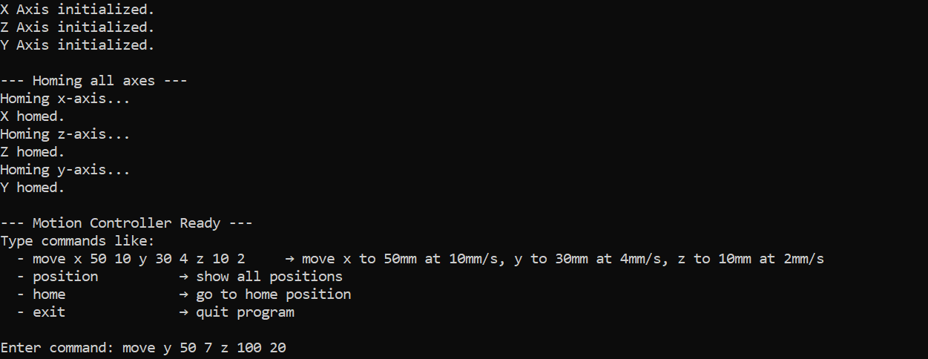
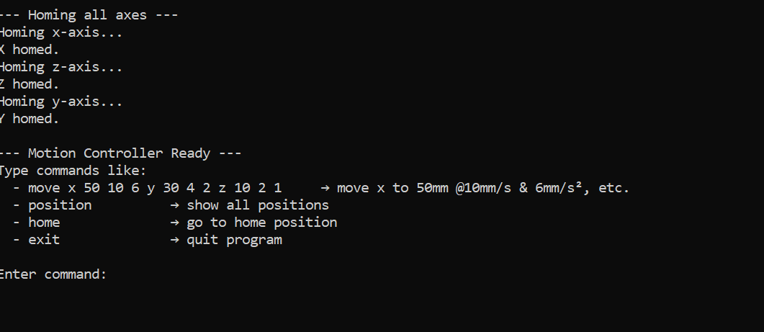
Commands Supported
move — Move one or more axes with position and speed
home — Send all axes to their starting (home) positions
position — Display current positions of all axes
exit — Stop and disconnect all devices safely

Slide 5
Goal
Team discussion of how the D-TACQ apparatus works.
Determine what is needed to test the probe setup
Demonstrate communication with OCTO-BEE and LTS-300
Wend 2 turns on the working coil

Slide 6
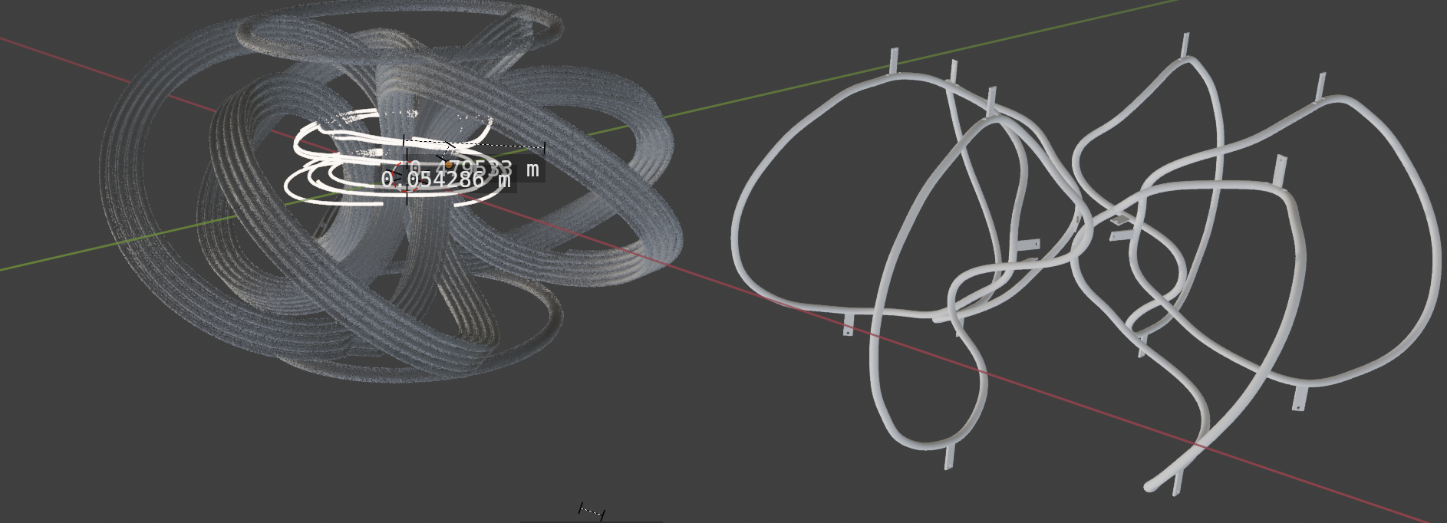
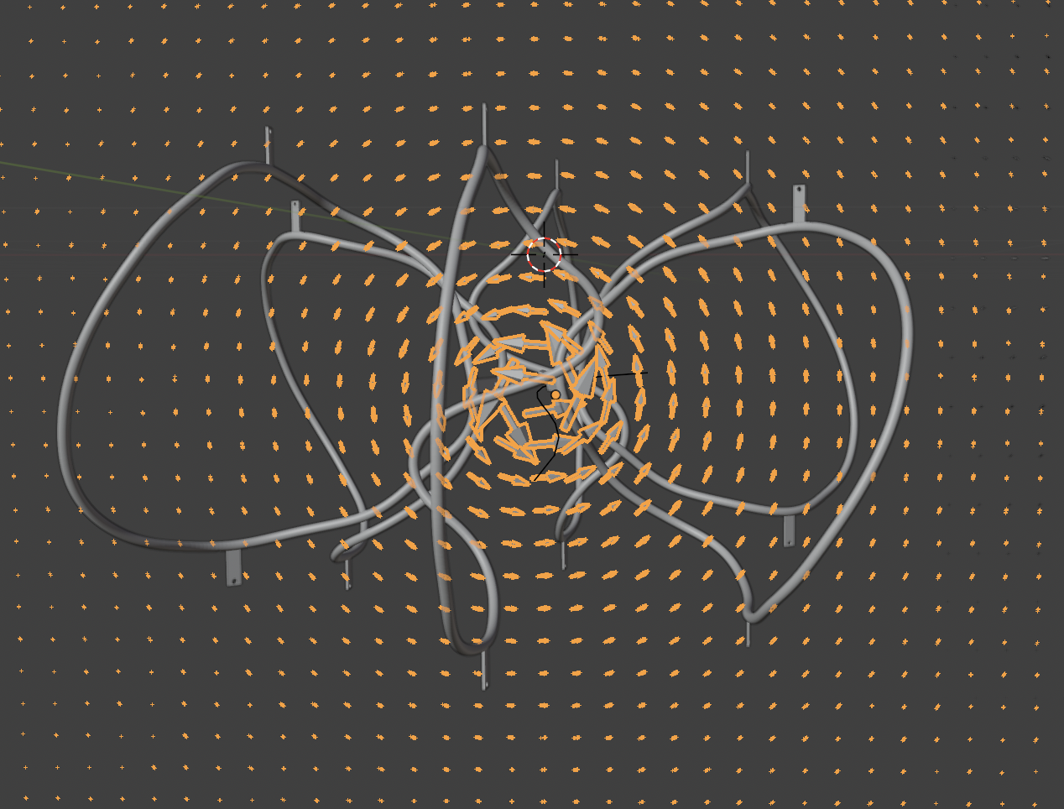
Current Work

Slide 7
Thank You
.

